Slide 1
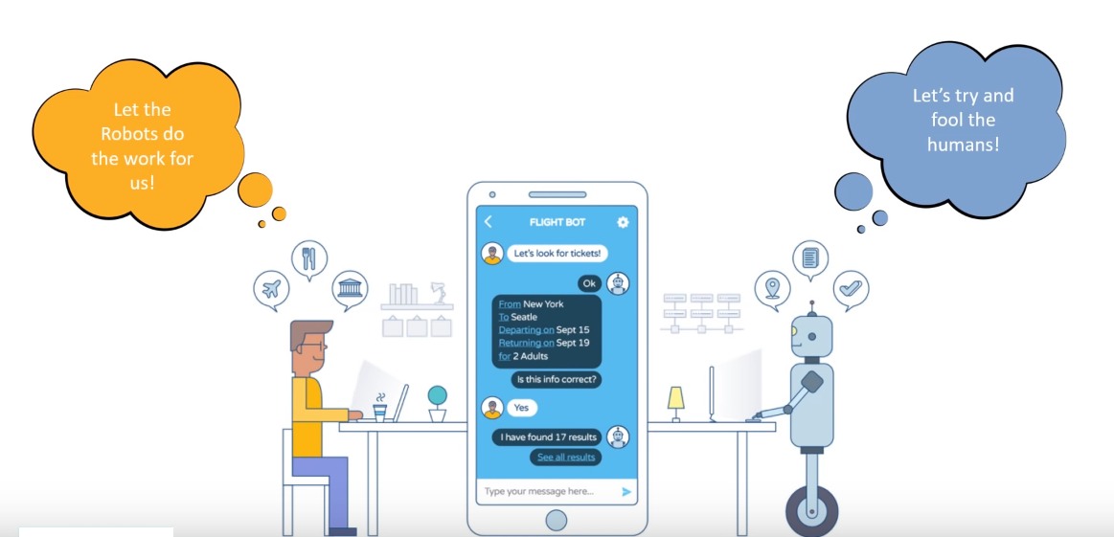
AI CHATBOT

Slide 2
PROJECT MEMBERS
PROJECT GUIDE
GUIDED BY
Prof. Atul Shintre
Mohd. Arbaj Ali
Sanket Gadge
Ashwin Sahu

Slide 3
What is CHATBOT?
A chatbot is an artificial intelligence (AI) software that can simulate a conversation (or a chat) with a user in natural language through messaging applications, websites, mobile apps or through the telephone.
Chatbot applications streamline interactions between people and services, enhancing customer experience.
However, from a technological point of view, a chatbot only represents the natural evolution of a Question Answering system leveraging Natural Language Processing (NLP).

Slide 4
ABSTRACT
For using software applications, user interfaces that can be used includes command line, graphical user interface (GUI), menu driven, form-based, natural language, etc. The mainstream user interfaces include GUI and web-based, but occasionally the need for an alternative user interface arises. A chat bot based conversational user interface fits into this space. They generally provide a stateful service i.e. the application saves data of each session. On a college’s website, one often doesn’t know here to search for some kind of information.
The solution to these comes up with a college inquiry chat bot, a fast, standard and informative widget to enhance a college website’s user experience and provide effective information to the user. Chat bots are an intelligent system being developed using artificial intelligence (AI) and natural language processing (NLP) algorithms. It has an effective user interface and answers the queries related to examination cell, admission, academics, users’ attendance and grade point average, placement cell and other miscellaneous activities.

Slide 5
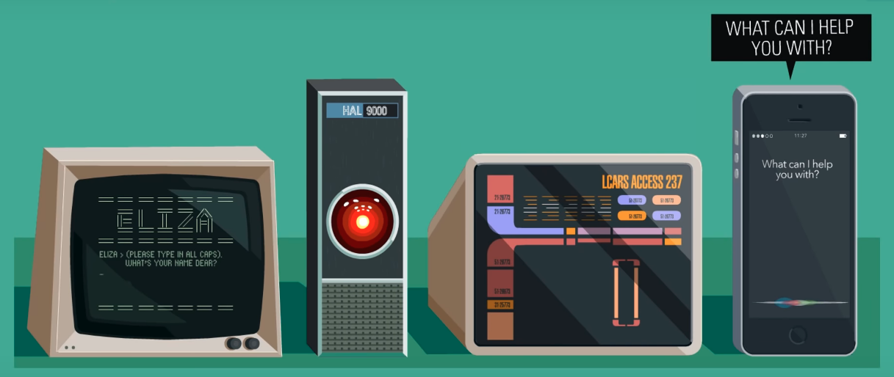
History of CHATBOT

Slide 6
Goals & Objectives
The purpose of a chat bot system is to simulate a human conversation.
Its architecture integrates a language model and computational algorithm to emulate information online communication between a human and a computer using natural language.
The college student and employees can freely upload their queries.
The chat bot provides fast and efficient search for answers to the queries and gets the relevant links to their question.

Slide 7
SCOPE
Simple chat bots were capable of matching a text string and offering an answer only when the exact match is found. When we said chatbots have come a long way, we actually meant it. The advanced chatbots today have a learning curve powered by artificial intelligence and is leading them to be of great significance.
The availability of chat bots 24/7 with the immense knowledge they can hold is all set to outperform humans. With speed and accuracy, they are offering support to enterprises, they will soon augment human capabilities. Users love to interact with chat bots as it saves them time and in most cases offers them clear and concrete answers. They may not be perfect but they are scary close to be perfect.

Slide 8
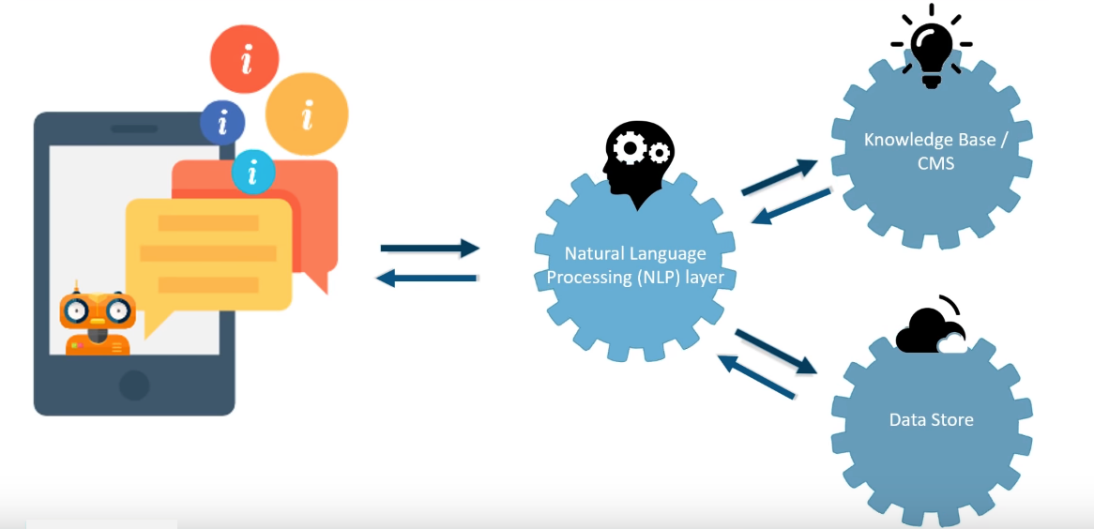
How does CHATBOT work?

Slide 9
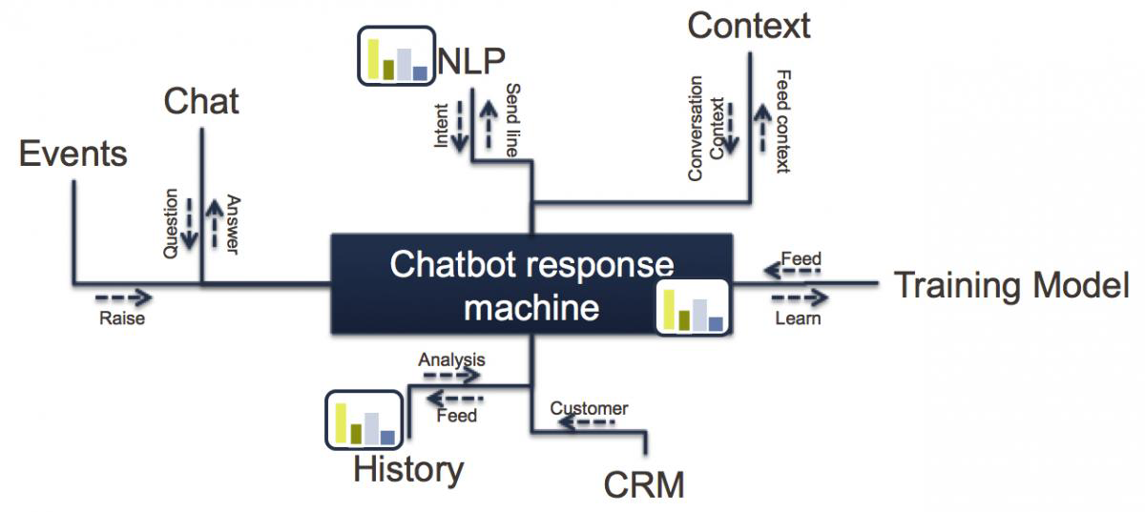

Slide 10
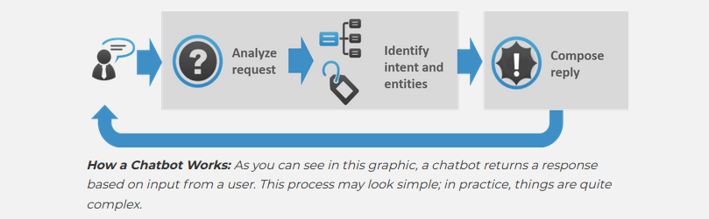
Workflow of CHATBOT

Slide 11
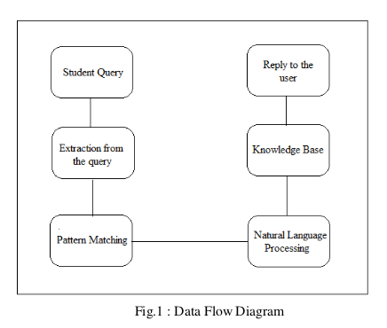

Slide 12
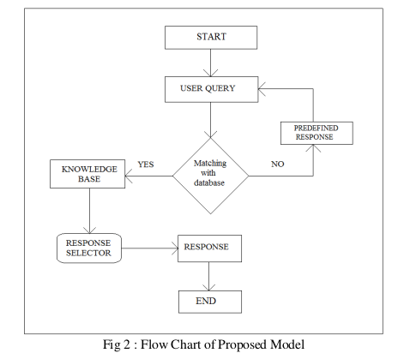

Slide 13
Hardware Requirements :
Operating System - Either 32bit or 64bit
Processor (CPU) of 2 GHz or above
A minimum of 2GB of RAM
DISC space - 200MB
An Internet connection.

Slide 14
Software Requirements :
Python
TKINTER
Tensorflow
NLP
HTML

Slide 15
USER INTERFACE DESIGNS

Slide 16
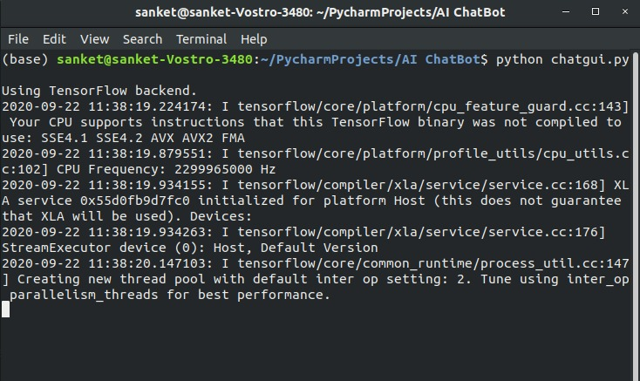

Slide 17
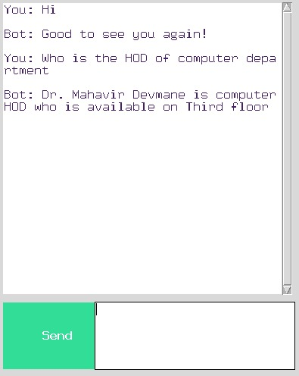

Slide 18
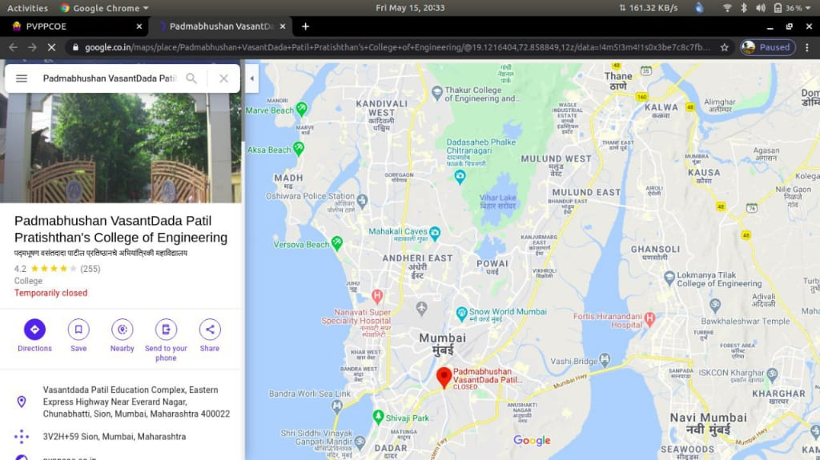

Slide 19
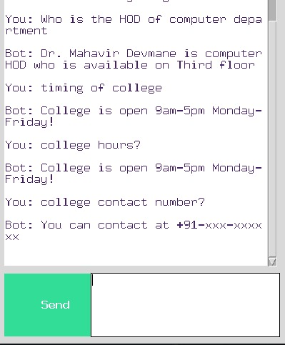

Slide 20
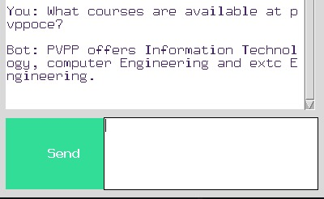

Slide 21
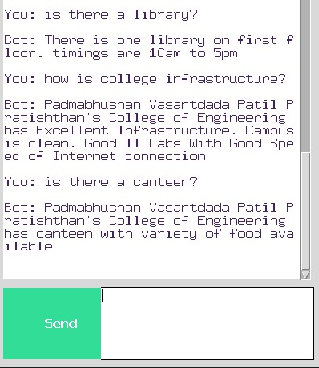

Slide 22
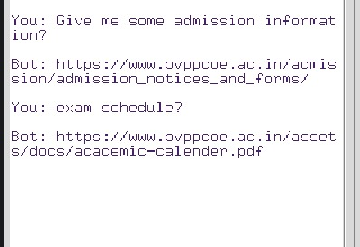

Slide 23
Conclusion :
Availability of resources when required with the help of chatbot without searching it other websites
Can help resolve the queries regarding college related stuffs
No need of harassments for staff people for similar queries
Available at any point of time other than college hours

Slide 24
FUTURE SCOPE
The future scope of this chatbot application will be
Can be integrated into our college website
More efficient and accurate chatbot
It will replace the classroom instruction, textbooks, practices, and homeworks
Live Chats, Video Calling features can be used in future to make the software more useful and demanding

Slide 25
